Slide 1
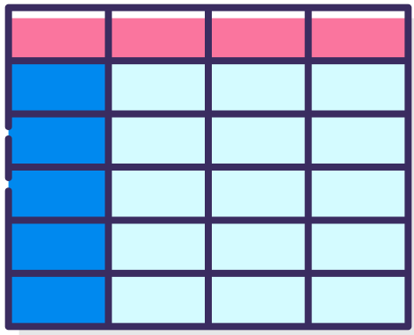
Table and matrix visualization
The table and matrix visualization helps to display categorical variables with text labels in the report.
Table visualization is just a normal grid containing related data in rows and columns.
Tables are a great choice to see numeric, quantitative, and exact precise values in tabular format.

Slide 2

Matrix Visualization
A matrix visual supports multiple dimensions, a stepped layout, aggregates data, and has a drill-down functionality.
Matrix visualization gives you the option to specify multiple variables in rows and columns.
To gain insights quicker, you can also apply conditional formatting.
At least two variables are required to create a matrix chart.

Slide 3
Benefits to a Matrix over Tables
Matrix visualizations also provides the ability to automatically calculate subtotals for number columns.
Matrix’s provide a more robust drill down experience to the end user.
This matrix allows for comparison of two categories at the same time.
With most Matrices, the indented or “Stepped” layout gives less clarity to which rows the values refer to.
Use Conditional Formatting.

Slide 4
Drillthrough Filter
Drillthrough filter is used to identify the columns that are to be used to drillthrough from one report page to another report page. Once the columns are selected, using the drillthrough command, the second report page only shows the selected (filtered) data.
Drillthrough filtering enables you to pass from first page to the second - but the detailed information are then limited to the item we drilled from.
It is essential to get a holistic understanding of your data, since you don’t have to rely on just one data visualization, report, or feature to put your point across.
Power BI Drillthrough lets you analyze the same data with different features and several visualization methods.

